Slide 1
Using Google Cloud Platform for Econometrics
Google Cloud Platform

Slide 2
Prerequisites
Need a Google Cloud Platform account
Go to https://cloud.google.com/ and set up a free trial account.
Need a background in econometrics / multi-variate statistics.
Some prior background in Python / R is helpful.

Slide 3
Storage Bucket Setup

Slide 4
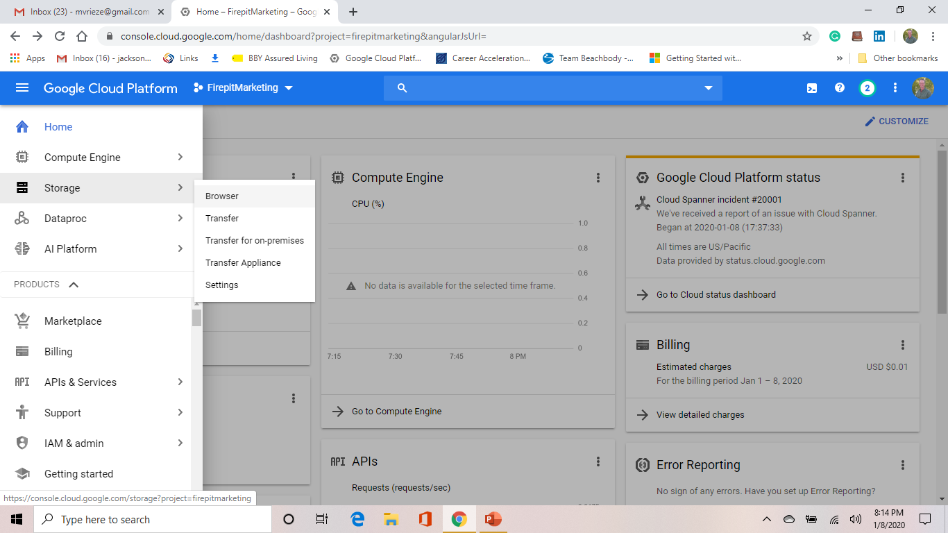
Storage Bucket Setup
Navigate to “Storage”
Select “Browser”

Slide 5
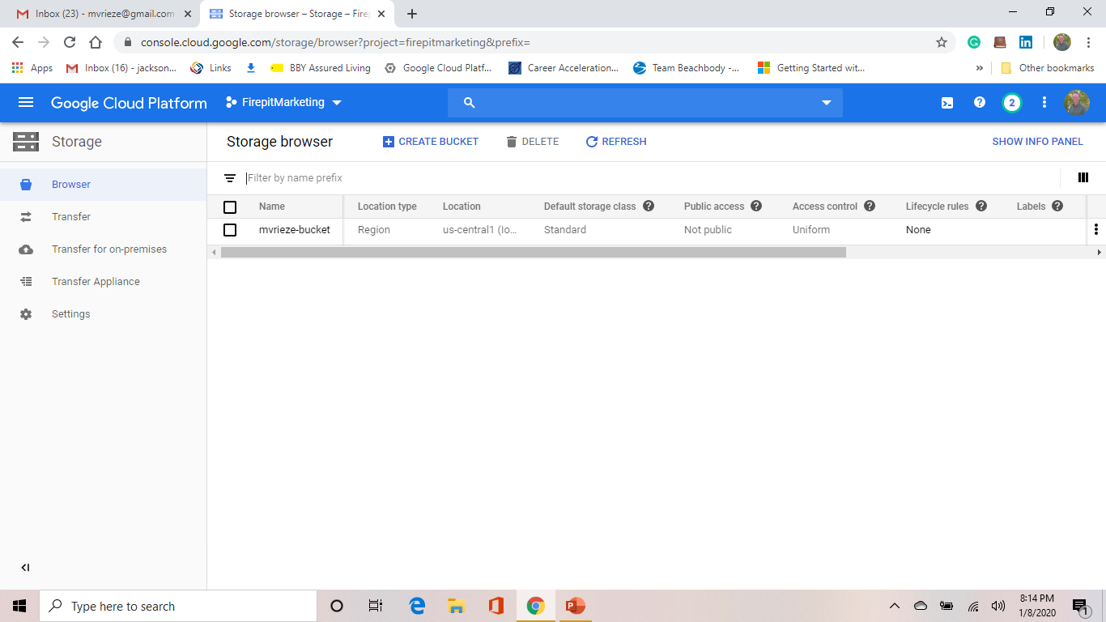
Storage Bucket Setup
Select “Create Bucket”

Slide 6
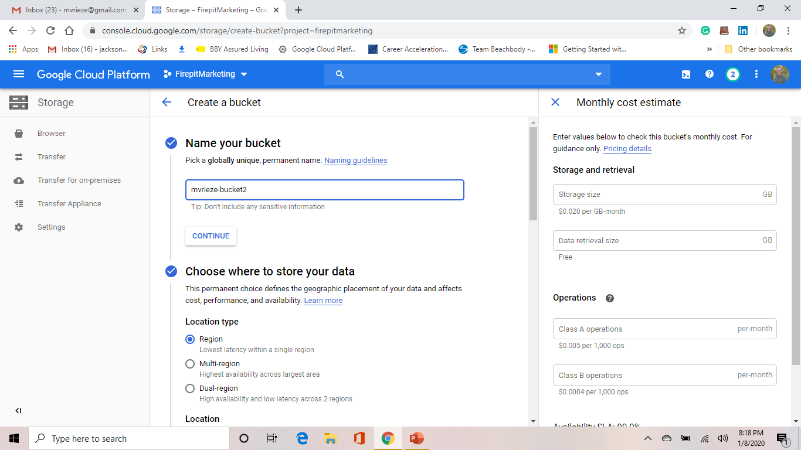
Storage Bucket Setup
Name your bucket
Choose a location type - “Region”

Slide 7
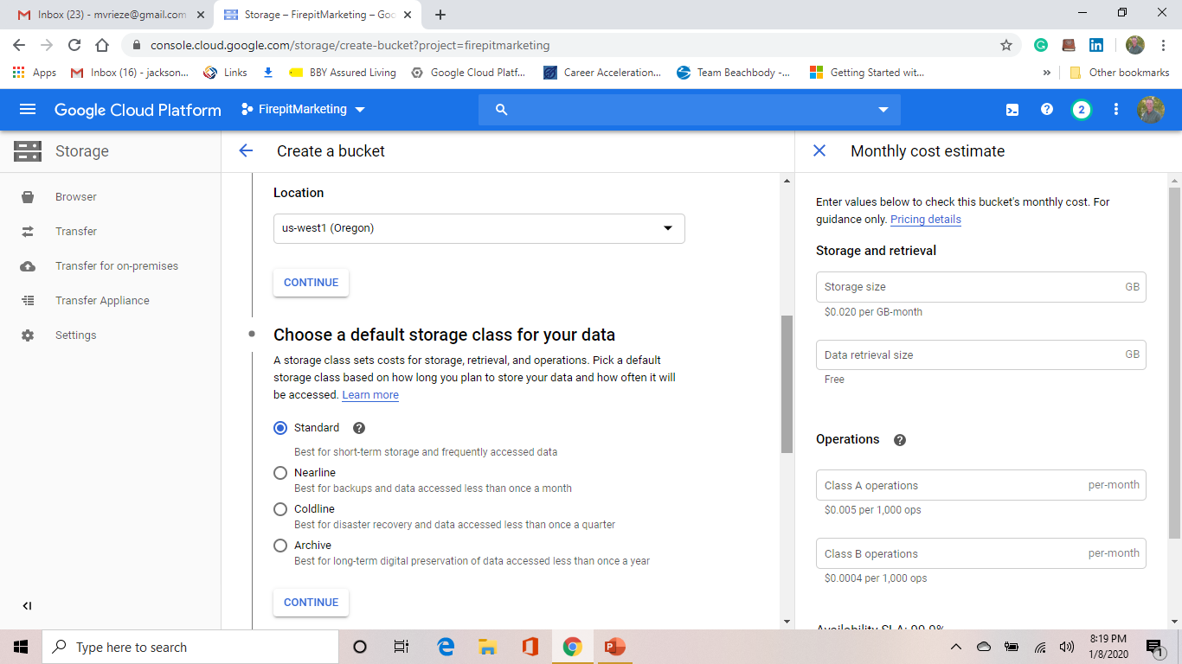
Storage Bucket Setup
Choose a Location – In this case, “us-west1 (Oregon)”
Choose the “Standard” storage class

Slide 8
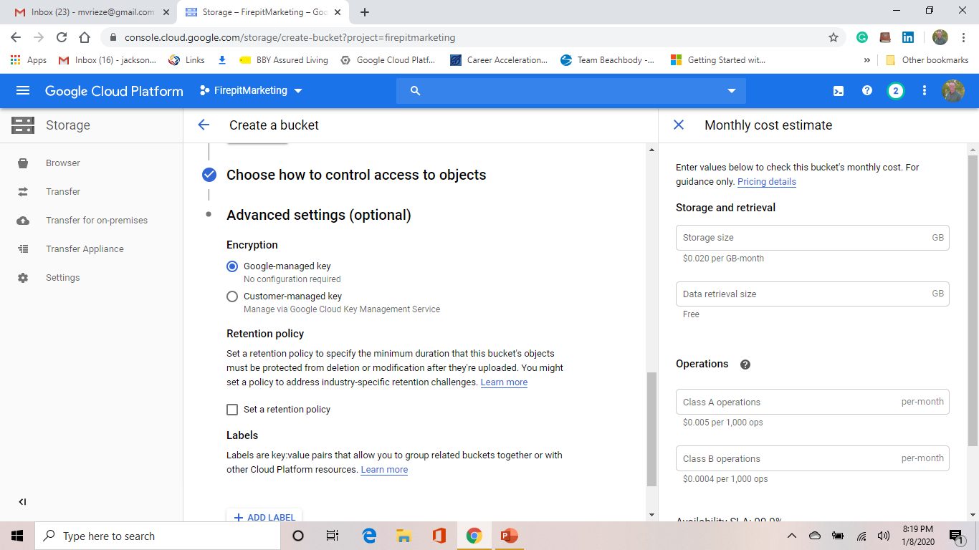
Storage Bucket Setup
Accept the default access control (Google-managed key)
Choose “Create” (at the bottom) to complete setup.

Slide 9
Storage Bucket Setup
Select the storage bucket you created

Slide 10
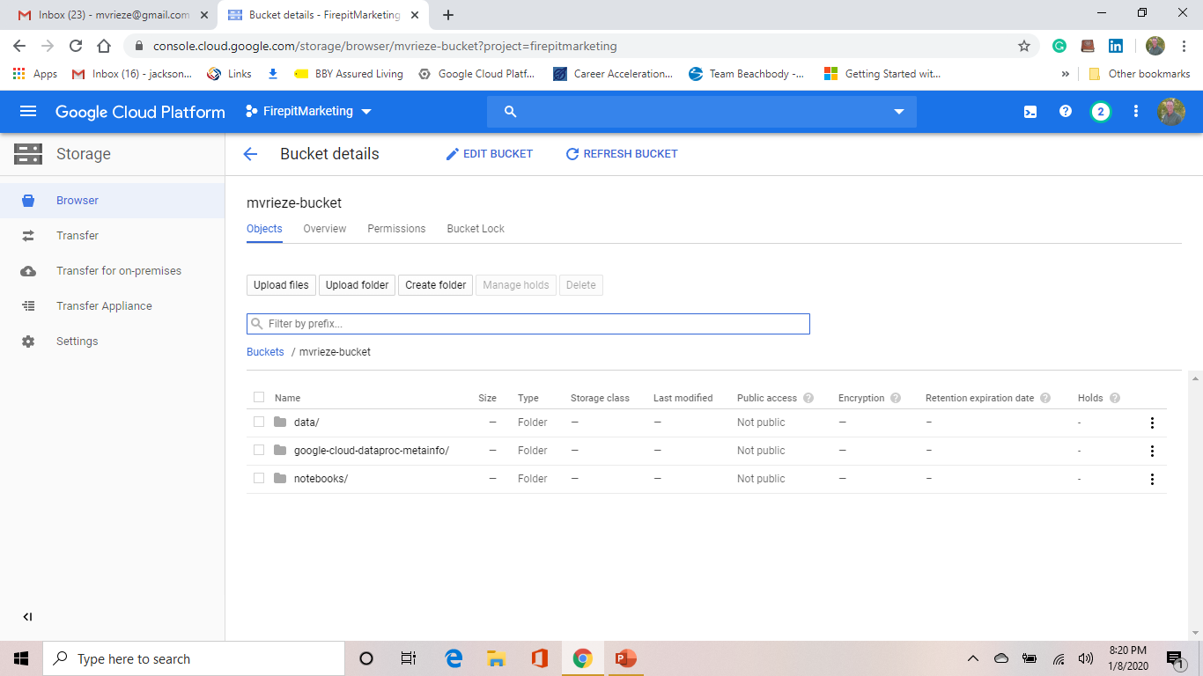
Storage Bucket Setup
Select “Create Folder” to set up a sub-folder inside your bucket and call it “data”.
Note that GCP will also use your storage bucket for other objects besides data. The screenshot also contains folders for Notebooks as well as Dataproc metadata.

Slide 11
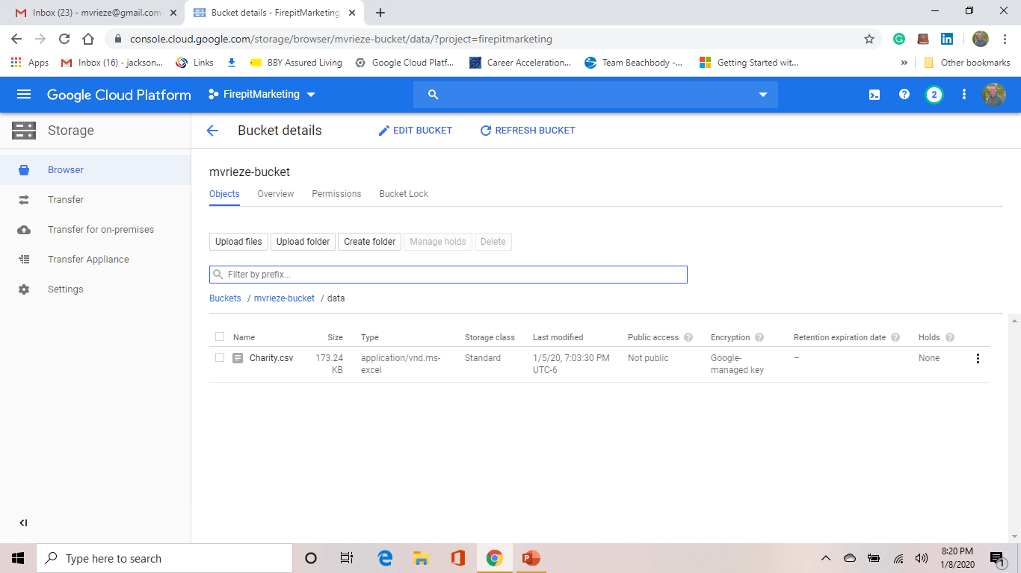
Storage Bucket Setup
Use the “Upload files” or “Upload folders” or “Create folder” buttons.
Note we have already uploaded the “Charity.csv” dataset to our “/data” folder.
Note that upload time depends on the speed of your internet connection, the size of the file and how you connect to GCP. For larger data sets, you might consider using the Google Cloud SDK tool.

Slide 12
Load Data to BigQuery

Slide 13
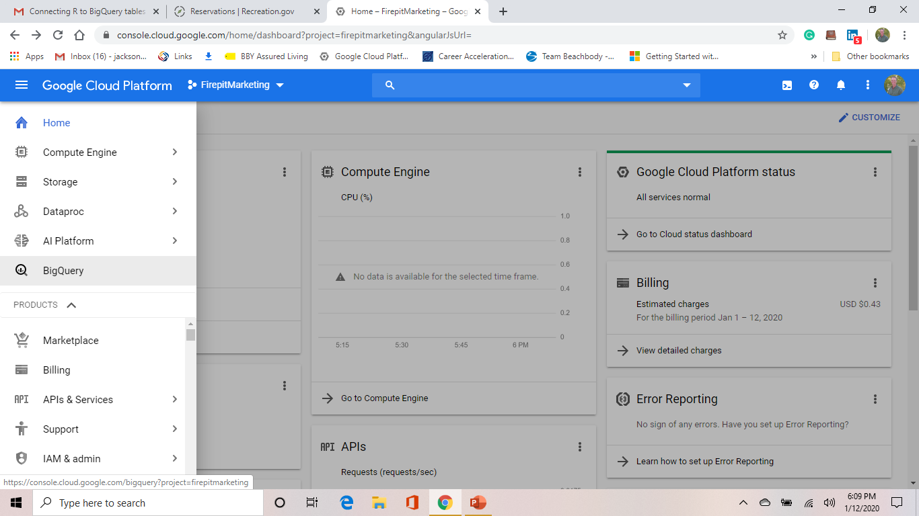
Load Data to BigQuery
Select “BigQuery.

Slide 14
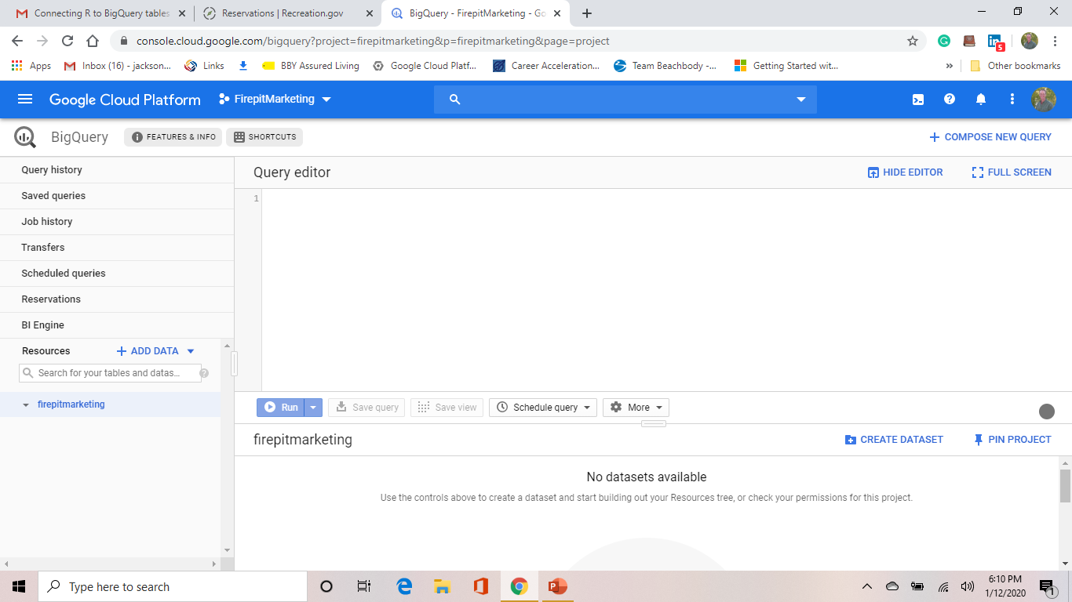
Load Data to BigQuery
Click on your project name.

Slide 15
Load Data to BigQuery
Select “Create Dataset”

Slide 16
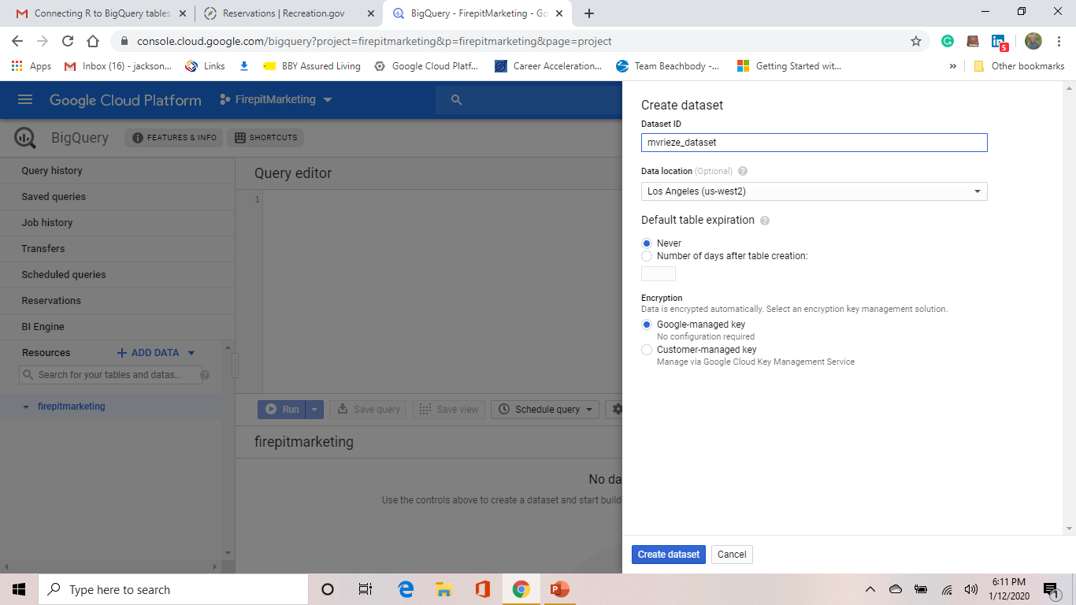
Load Data to BigQuery
Set a name for the dataset
Choose a region – We recommend the generic “United States” region
Leave the default table expiration and encryption defaults and select “Create Dataset.

Slide 17
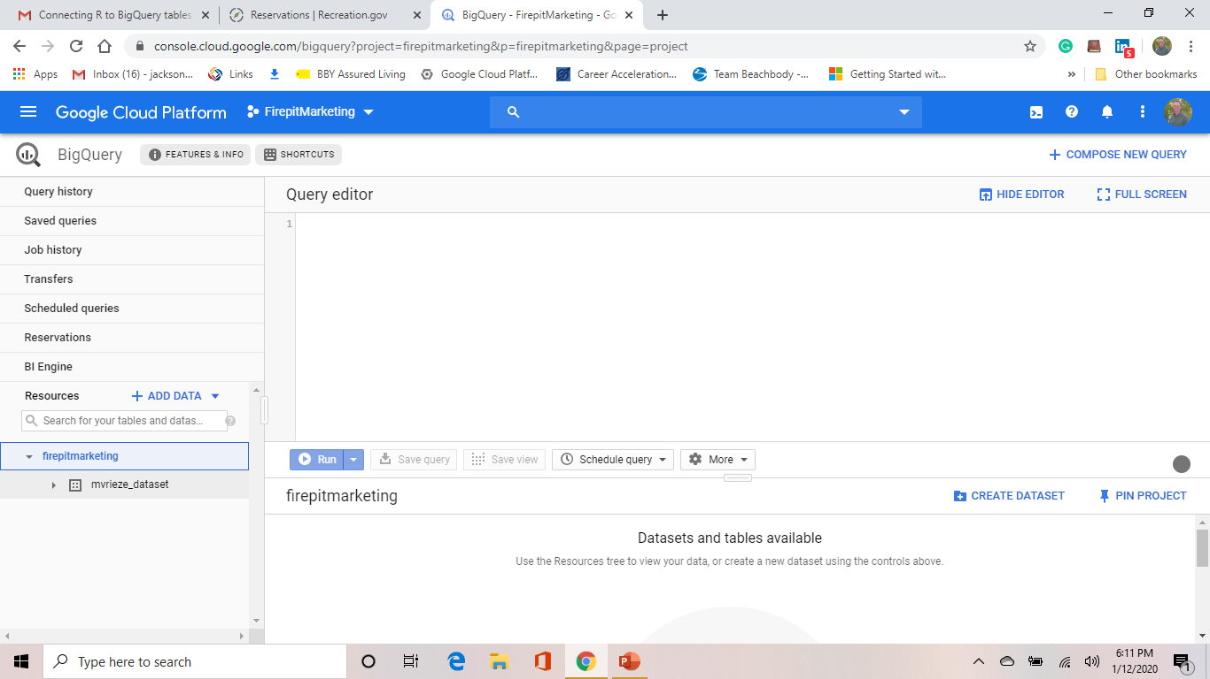
Load Data to BigQuery
Your dataset now appears below your project name.
Click on your new dataset.

Slide 18
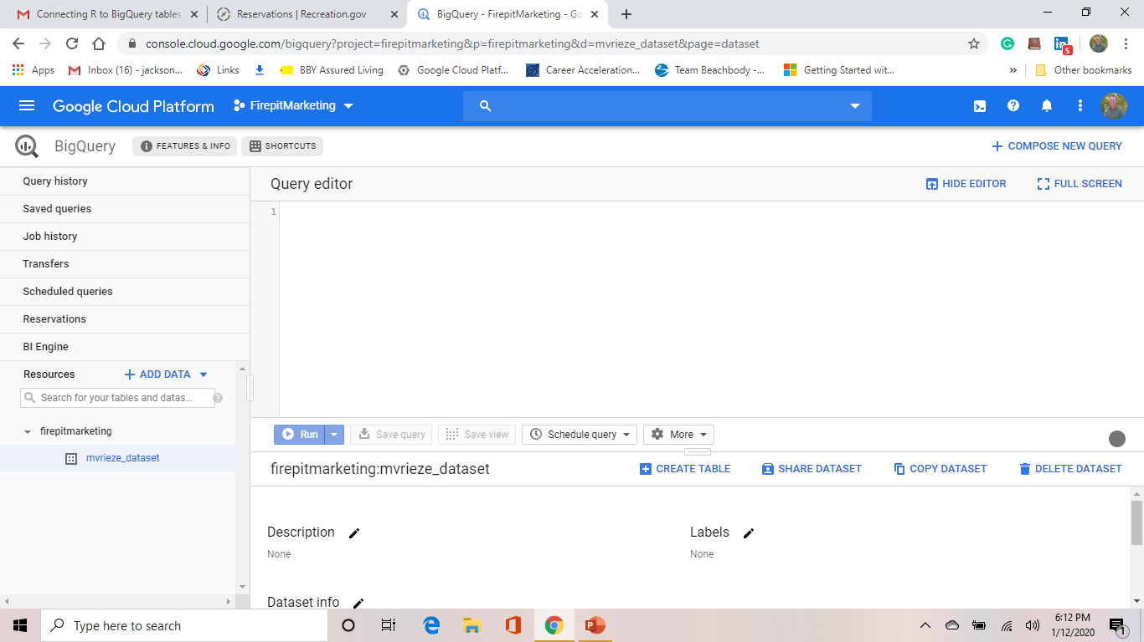
Load Data to BigQuery
Click on “Create Table”.

Slide 19
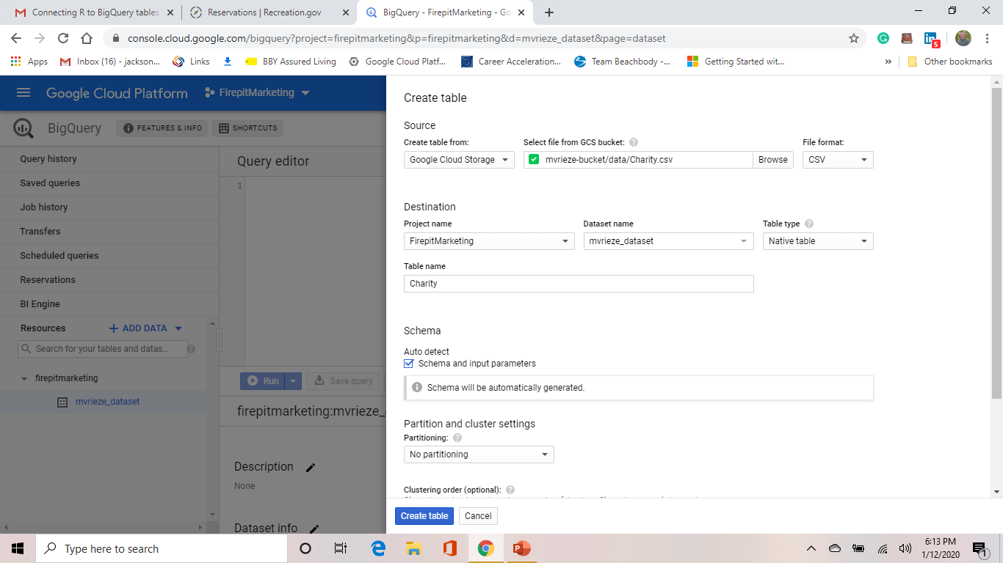
Load Data to BigQuery
Select Google Clod Storage and browse/select the Charity.csv file we uploaded earlier.
Be sure to check the “Auto detect” box and then select “Create Table”

Slide 20
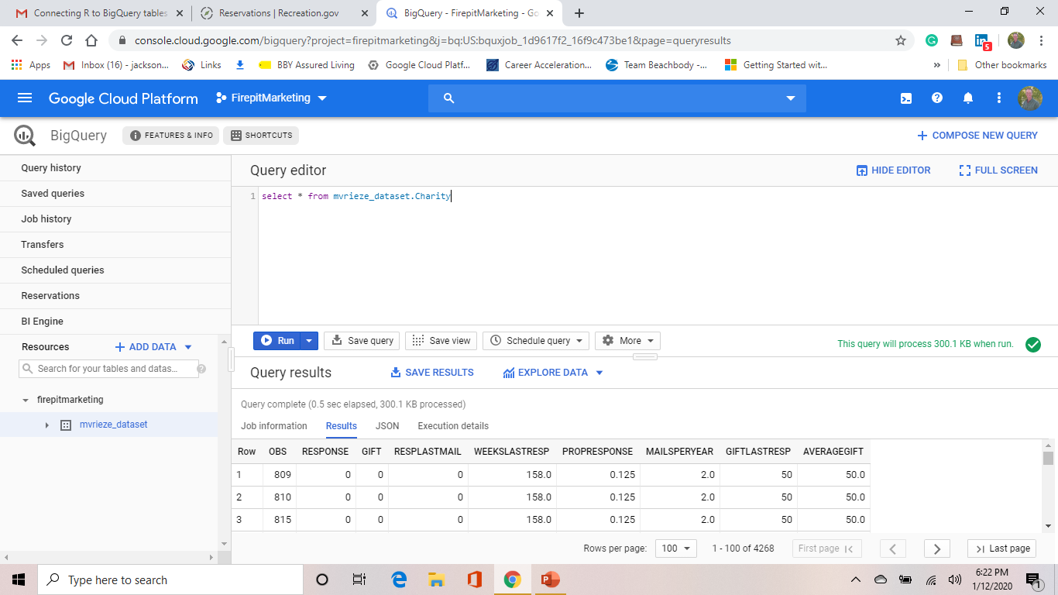
Load Data to BigQuery
In the query editor, write a simple select query and select “Run”
Results appear in bottom box.

Slide 21
Virtual Machine Setup

Slide 22
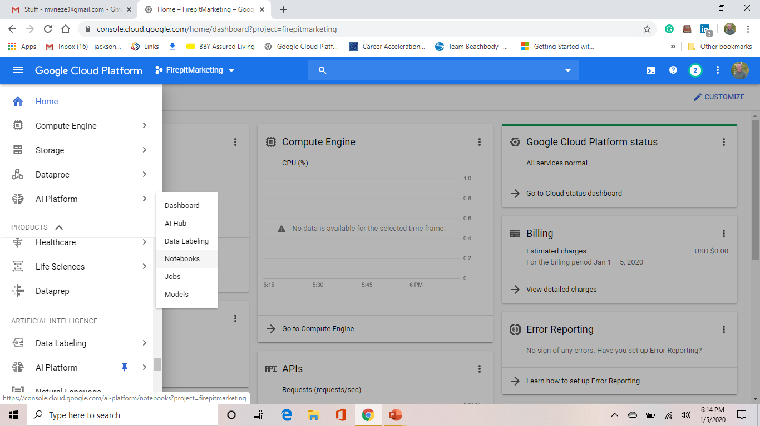
Virtual Machine Setup
Navigate to “AI Platform”
Select “Notebooks”

Slide 23
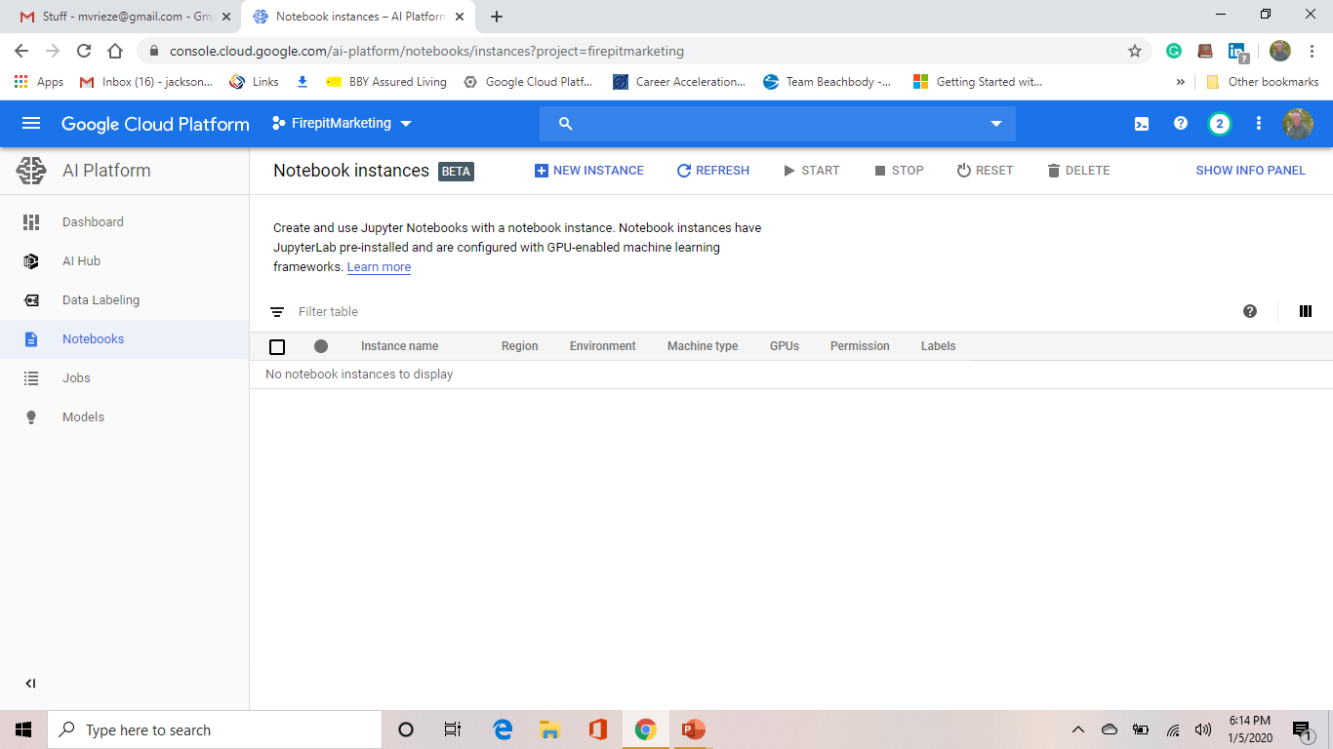
Virtual Machine Setup
Select “+ New Instance”

Slide 24
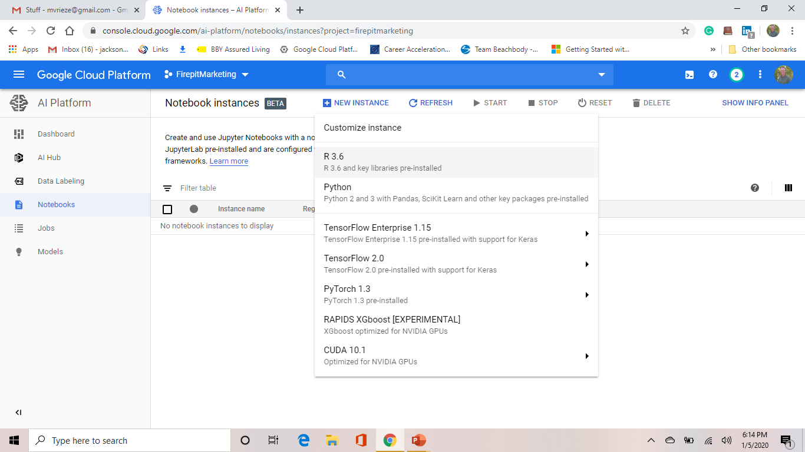
Virtual Machine Setup
Select “R 3.x” (If you wanted Python, don’t worry – Python comes along for the ride)

Slide 25
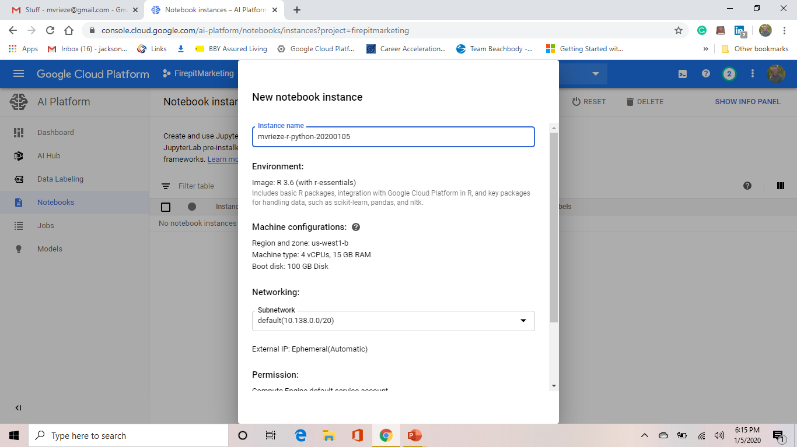
Virtual Machine Setup
Name your instance
Choose your configuration
Rule of thumb: You need 3x the size of your data in memory to handle your project.

Slide 26
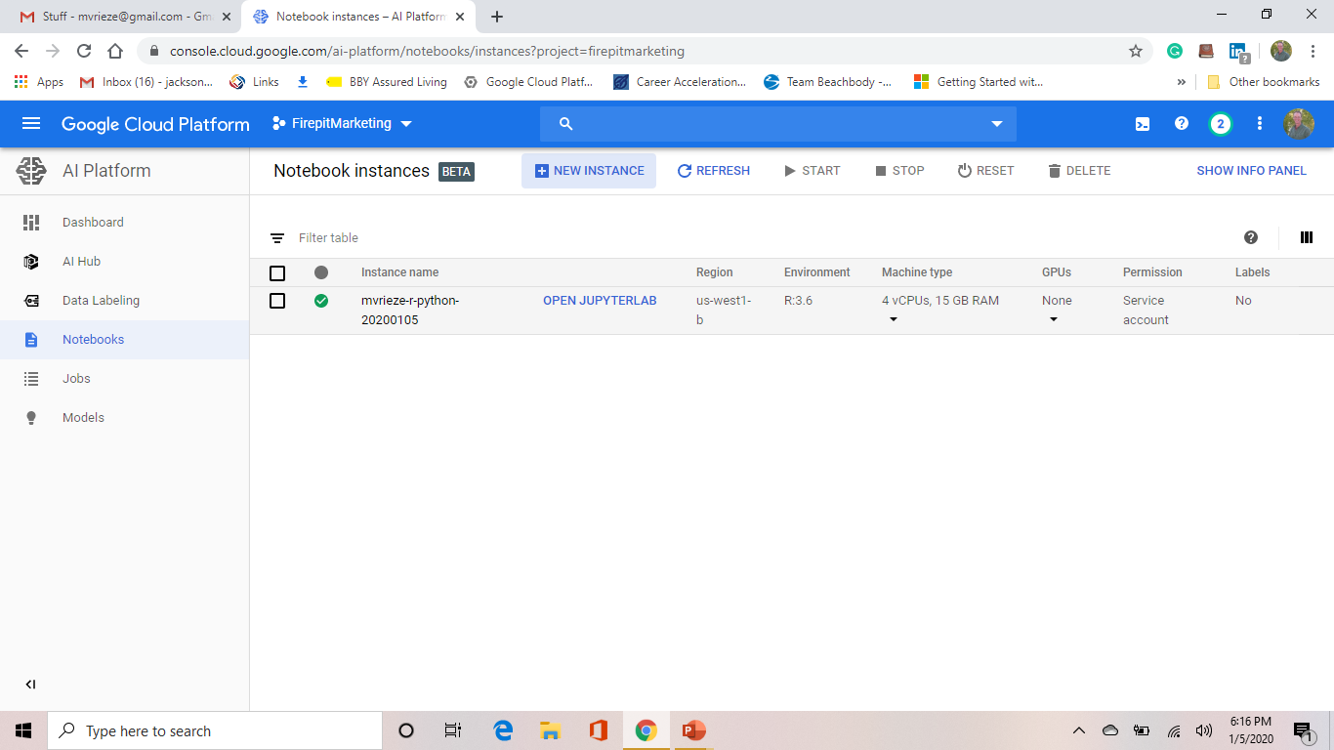
Virtual Machine Setup
Select “Open Jupyterlab”

Slide 27
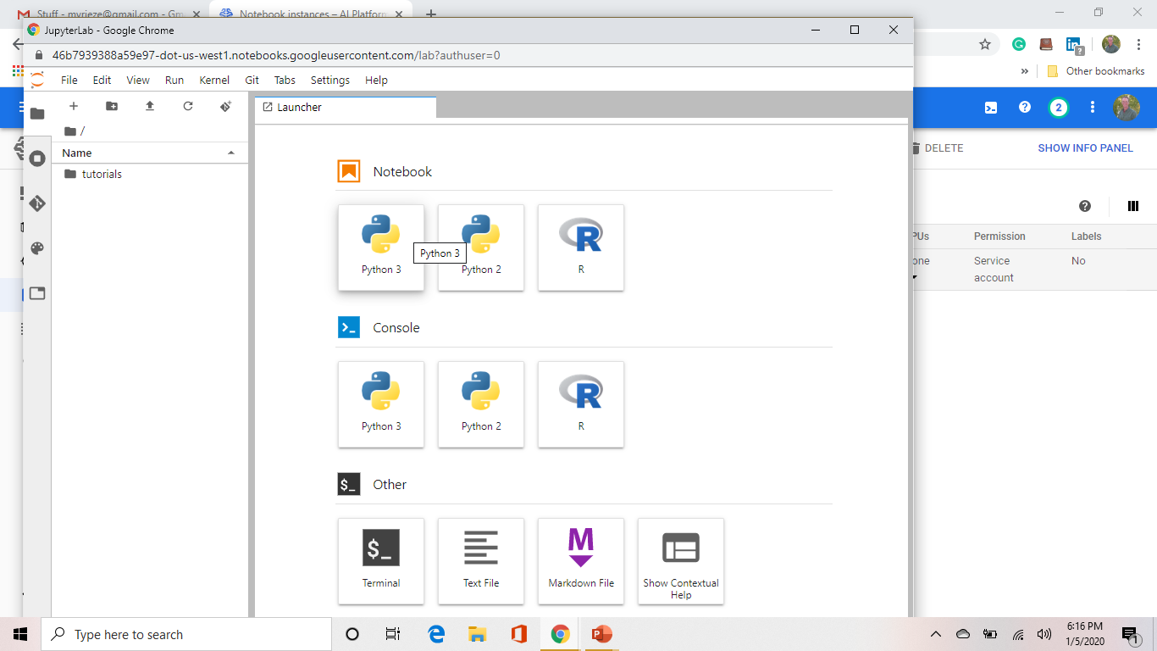
Virtual Machine Setup
Select whichever tool you wish to use (R or Python – notebook or console)

Slide 28
Connect Python to GCP Storage Bucket

Slide 29
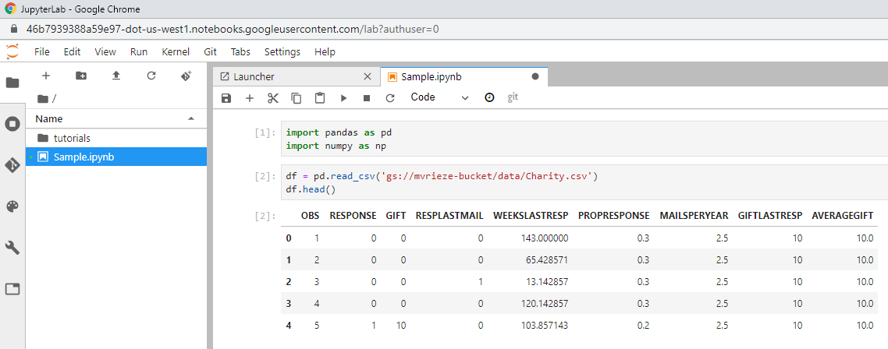
Connect Python to GCP Storage Bucket
https://stackoverflow.com/questions/49357352/read-csv-from-google-cloud-storage-to-pandas-dataframe
Code:
# Note how easy it is to connect to a csv file in This is really easy
import pandas as pd
import numpy as np
df = pd.read_csv('gs://bucket-name/folder-name/file-name.csv')

Slide 30
Connect Python to Google BigQuery

Slide 31
Connect Python to Google BigQuery
https://pypi.org/project/google-cloud-bigquery/
https://cloud.google.com/bigquery/docs/datalab-migration
Code:
import numpy as np
import pandas as pd
# Import the library
from google.cloud import bigquery
# Instantiate the client
client = bigquery.Client()
#Write the query - note the ticks surrounding project.dataset.table
sql = """
SELECT * from `firepitmarketing.mvrieze_dataset.Charity`
"""
#Execute the query and set results to Pandas dataframe
df1 = client.query(sql).to_dataframe()
print(df1.head())

Slide 32
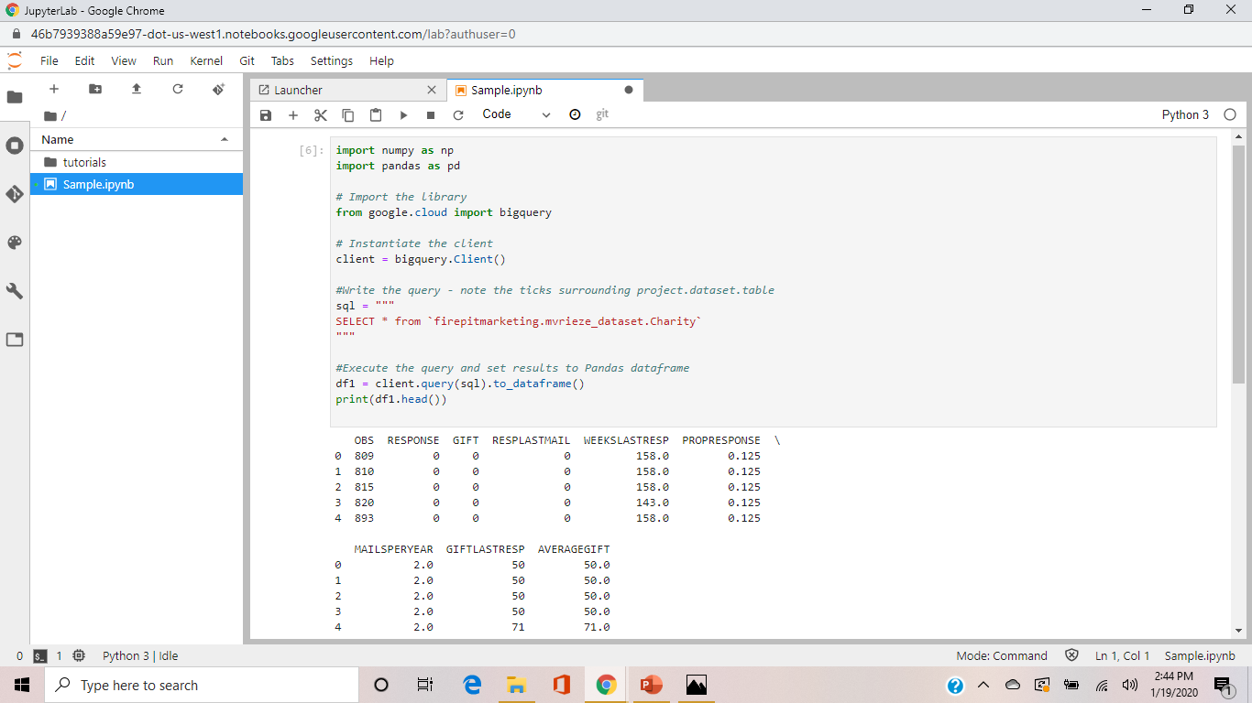
Connect Python to Google BigQuery

Slide 33
Connect R to GCP Storage Bucket

Slide 34
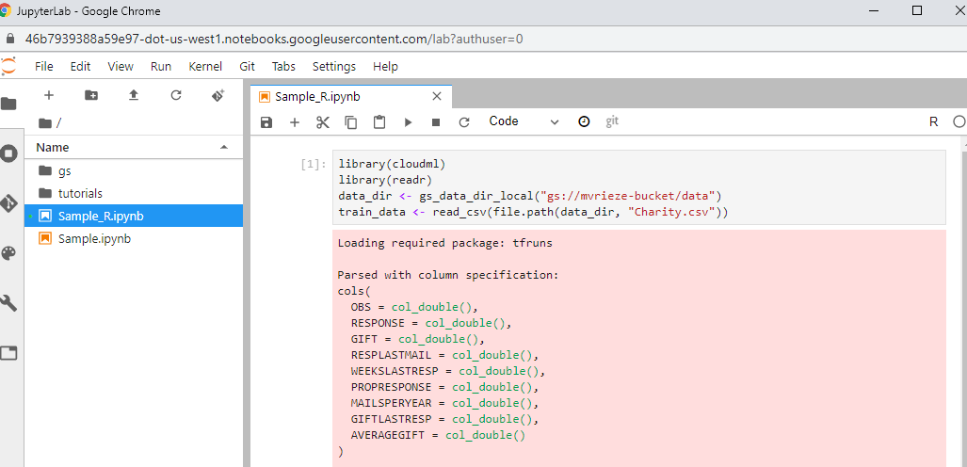
Connect R to GCP Storage Bucket
https://cran.r-project.org/web/packages/cloudml/vignettes/storage.html
Code:
library(cloudml)
library(readr)
data_dir <- gs_data_dir_local("gs://bucket/path_in_bucket")
train_data <- read_csv(file.path(data_dir, "filename.csv"))

Slide 35
Connect R to Google BigQuery

Slide 36
Connect Python to Google BigQuery
https://cloud.google.com/ai-platform/notebooks/docs/use-r-bigquery
https://bigrquery.r-dbi.org/
Code:
# Load the package
library(bigrquery)
# Add another notebook block and paste in the following block
# Provide authentication
bq_auth(use_oob = TRUE)
# Add another notebook block
# Store the project id
projectid = “firepitmarketing"
# Set your query – note the ticks around the <project name>.<data set name>.<table name>
sql <- "SELECT * from `firepitmarketing.mvrieze_dataset.Charity`"
# Run the query and store the data in a dataframe
df <- query_exec(sql, projectid, use_legacy_sql = FALSE)
# Print the query result
df

Slide 37
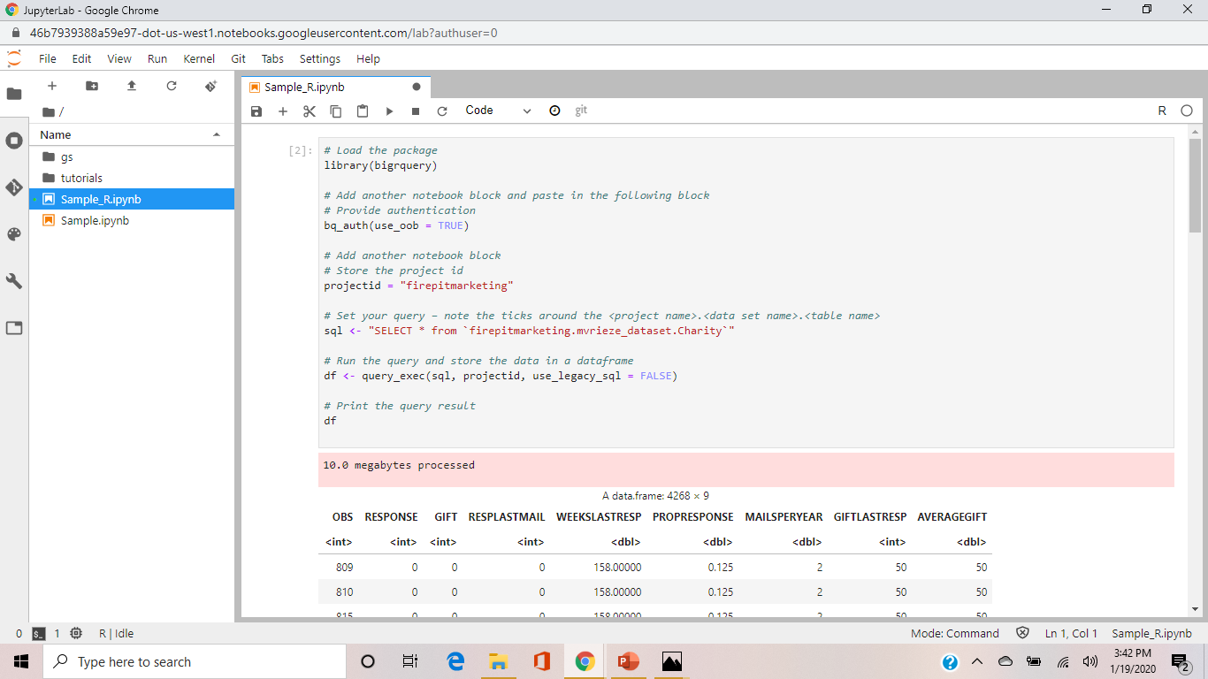
Connect Python to Google BigQuery

